Slide 1

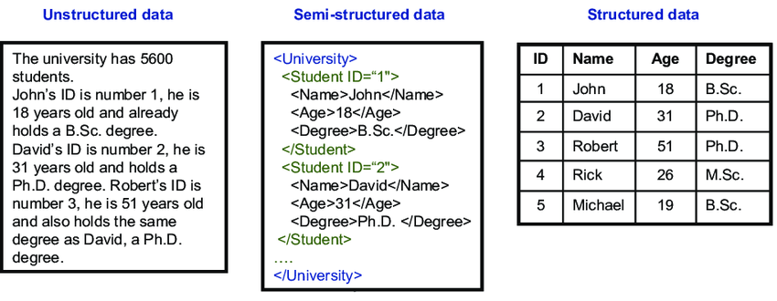
IRONHACK BOOTCAMP

Slide 2
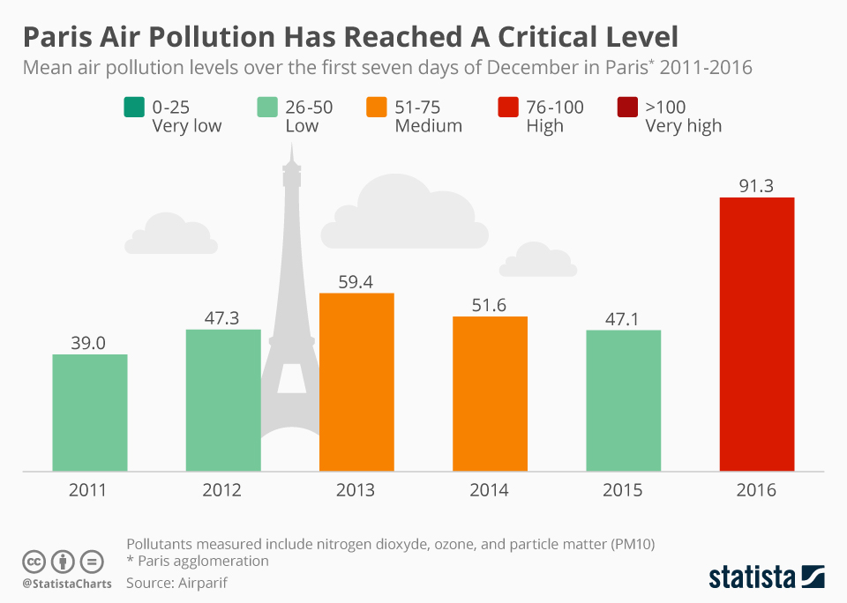
IRONHACK BOOTCAMP
Air pollution data collection | Unstructured - Semi Structured

Slide 3

Production architecture: Data Warehouse, Lake
DATA ANALYTICS | IRONHACK

Slide 4
Sian’s client case study data question -> data sources

Slide 5

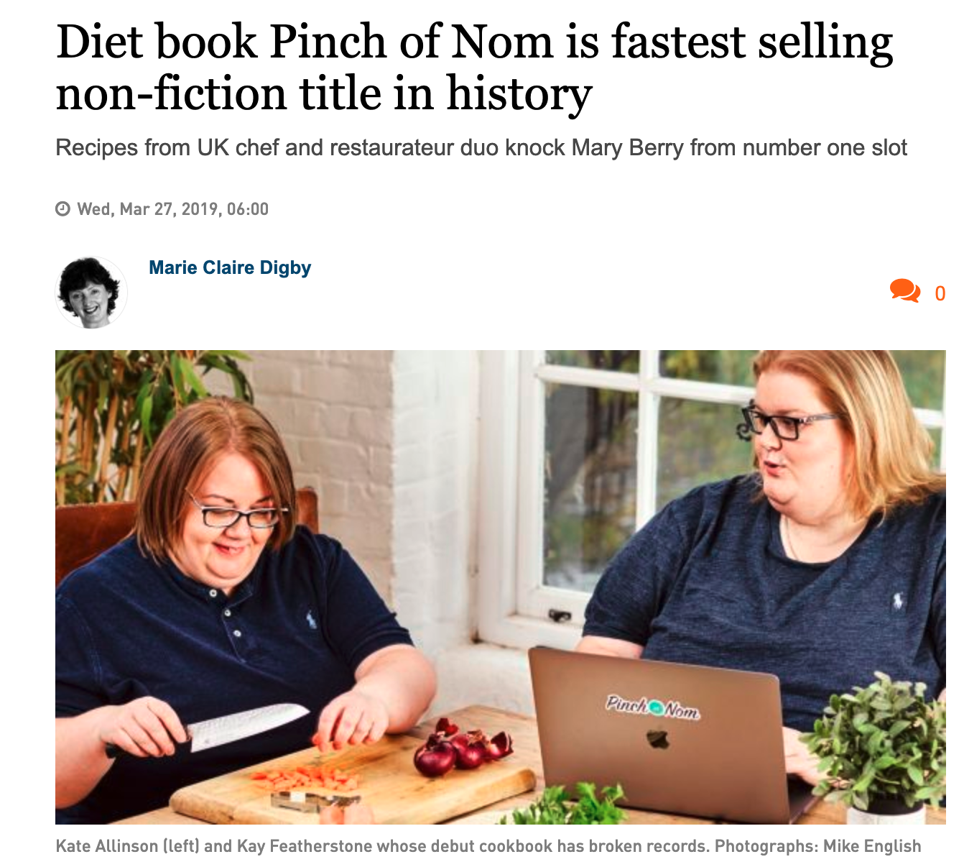

IRONHACK BOOTCAMP
Q: “What is the next best
seller /overnight success?”

Slide 6

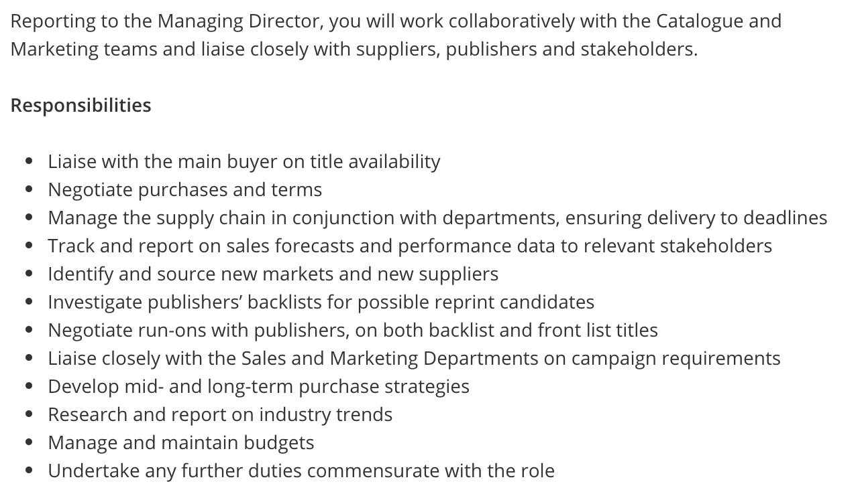
IRONHACK BOOTCAMP
What does a book buyer do ?

Slide 7
IRONHACK BOOTCAMP
Q: “What is the next best
seller /overnight success?”

Slide 8
IRONHACK BOOTCAMP
DATA SOURCES :
Q: “What is the next best
seller /overnight success?”

Slide 9
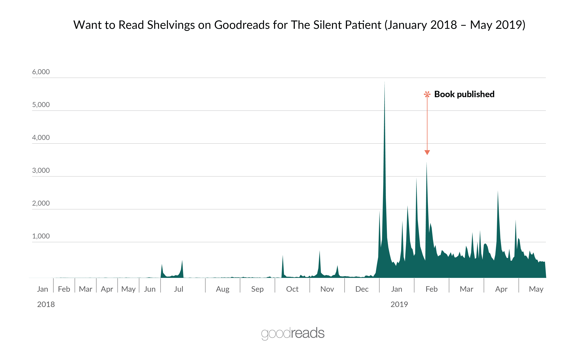
IRONHACK BOOTCAMP
Q: “What is the next best
seller /overnight success?”
Link to source

Slide 10
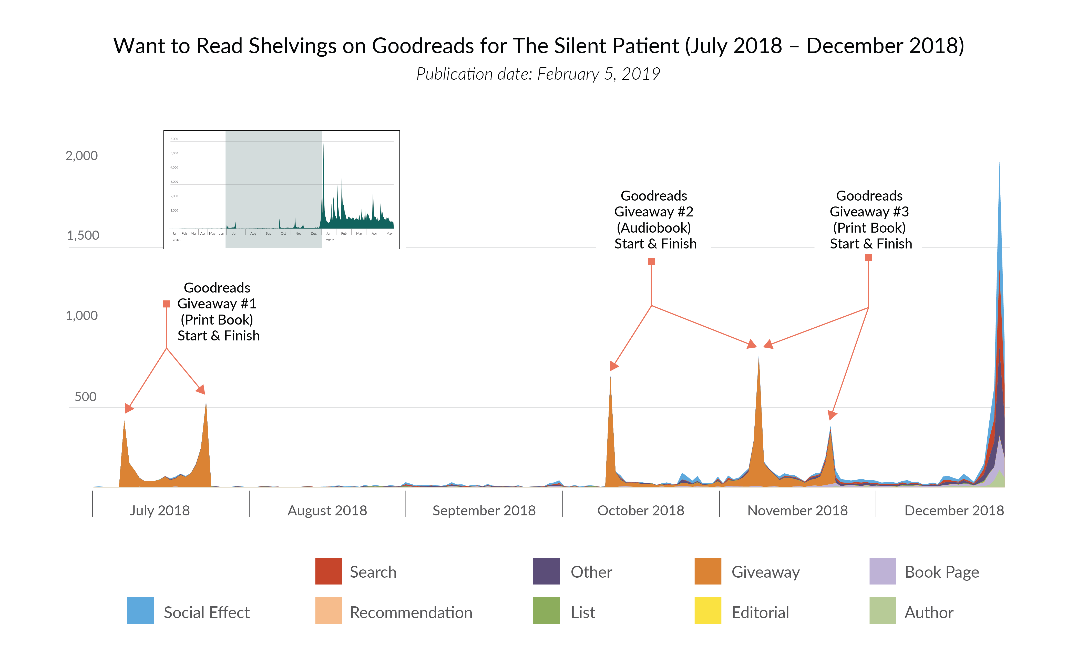
IRONHACK BOOTCAMP
Q: “What is the next best
seller /overnight success?”

Slide 11
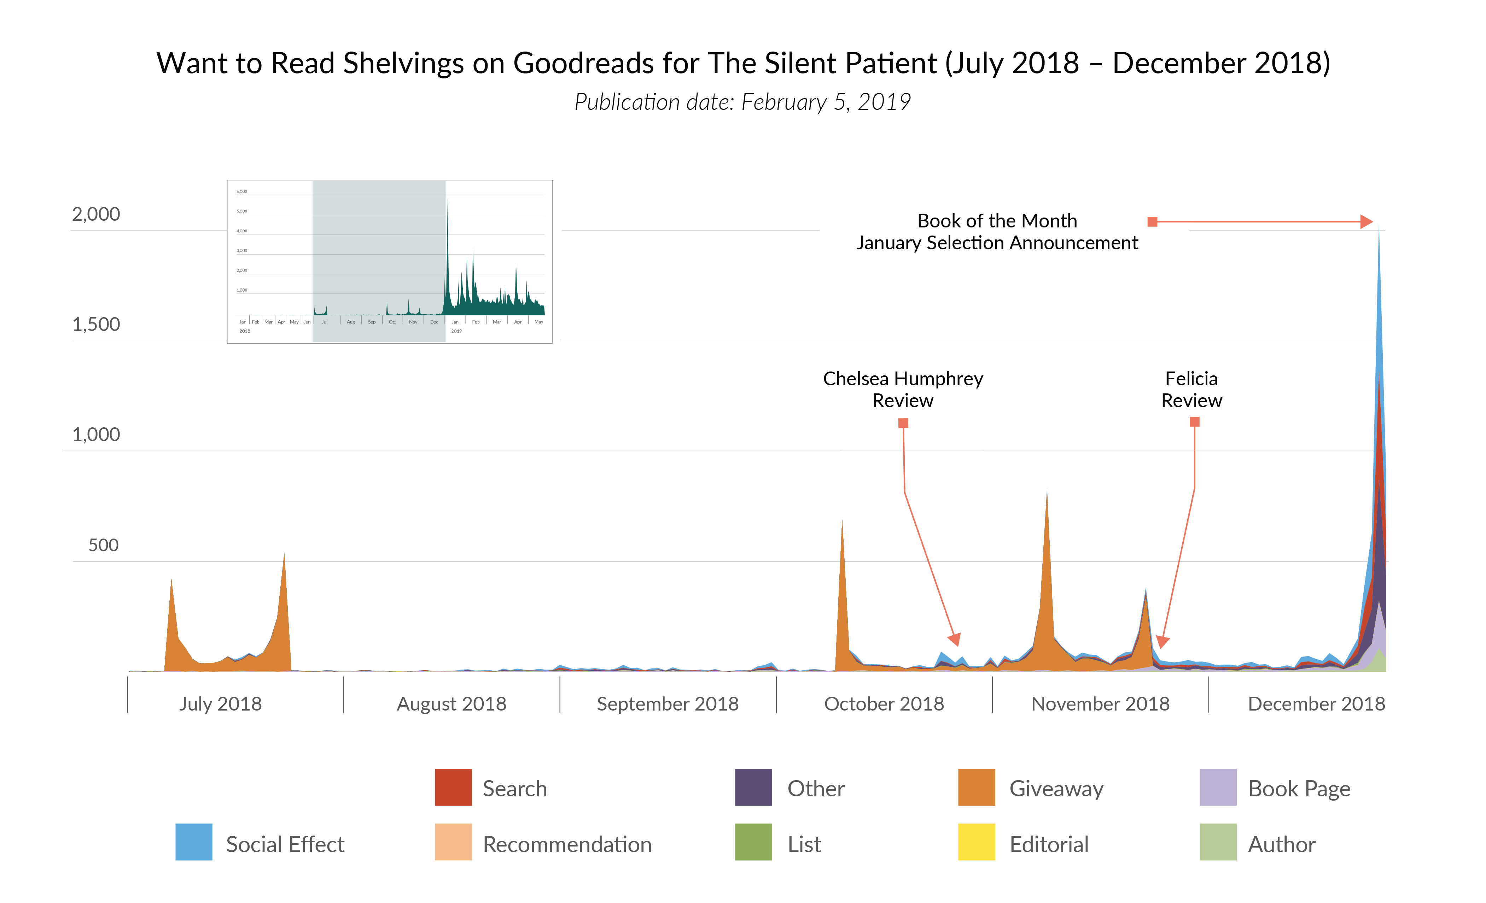
IRONHACK BOOTCAMP
Q: “What is the next best
seller /overnight success?”

Slide 12
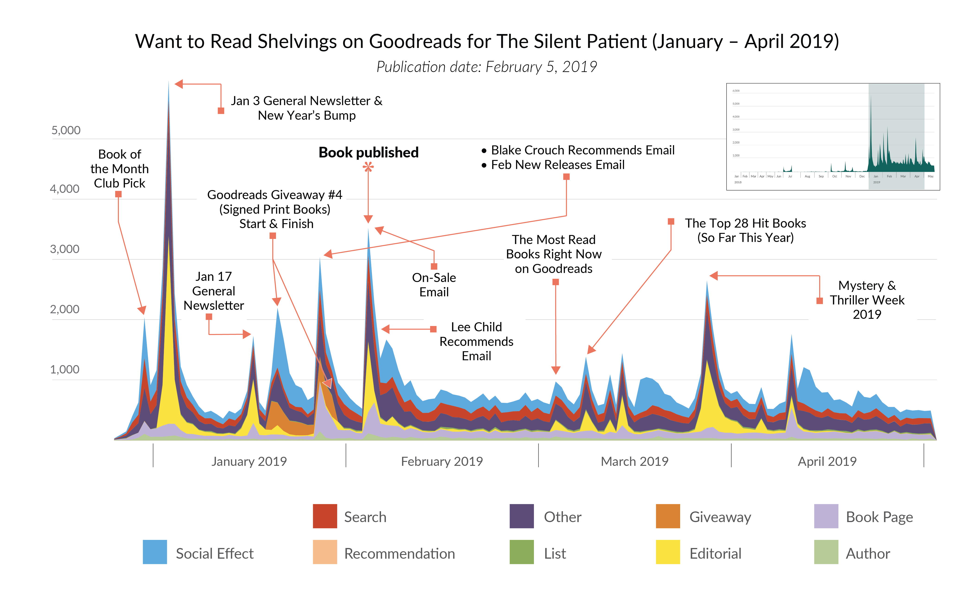
IRONHACK BOOTCAMP
Q: “What is the next best
seller /overnight success?”

Slide 13
data architecture Storage options for big data

Slide 14
IRONHACK BOOTCAMP
Data Architecture | The system
What is it:
It’s a big umbrella term that encapsulates data storage, computational resources, and everything in between
All technologies that support data collection, storage, processing, and dashboarding is included in the architecture
Data Architects are people who translate business needs and design and build these systems, calculate ROI, monitor backups and fault tolerance, and support change management

Slide 15
IRONHACK BOOTCAMP
Big Data | how big is it?
Examples of machine-generated data sources:
● Sensors on vehicles, appliances and industrial machinery
● Cameras used for security vigilance
● Satellites
● Medical devices
● Personal tools -smartphone apps | fitness trackers
Examples of human-generated data sources:
● image and video sharing
● likes and comments
● instant messenger
● status changes
- if we take all the data generated in the world between the beginning of time and 2008 the same amount of data will soon be generated every single minute.
(Bernard Marr, Bernard Marr & Co.)

Slide 16
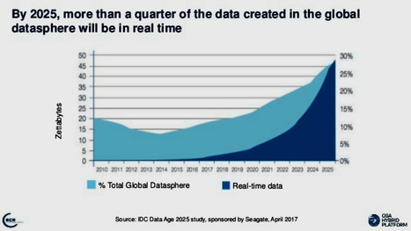
IRONHACK BOOTCAMP
Big Data | how big is it?
In 2018, the total amount of data created, captured, copied and consumed in the world was 33 zettabytes (ZB) – the equivalent of 33 trillion gigabytes
This grew to 59ZB in 2020 and is predicted to reach 175ZB by 2025

Slide 17
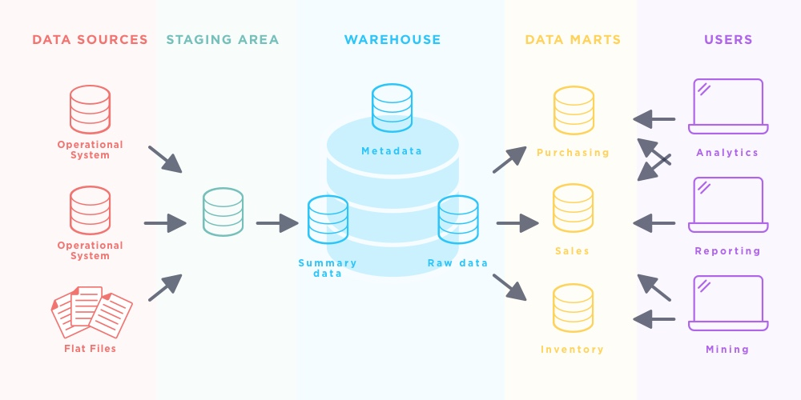
IRONHACK BOOTCAMP
Data Architecture | The data warehouse

Slide 18

IRONHACK BOOTCAMP
TYPES OF
DATA STORAGE
Data Lake
DBs
DWs
Data Marts
Data dump
Repository to store all kinds of data, in its natural format
Data storage system
Stores data in a structured format for easy retrieval
Database that integrates databases
for analytical purposes
Store data from DWs
to be used by a specific business function

Slide 19
IRONHACK BOOTCAMP
DATA | WAREHOUSE
What is it:
It is a copy of transactional data structured for querying and reporting
It can be a relational database, a multidimensional database, or a flat file, etc.
It can be normalized or denormalized; used to consolidate information from multiple resources for improved query performance
The main purpose is data mining, data visualization, and advanced reporting
Data is stored in DWs from operational DBMS (OLTPs – which are usually designed independently of each other and is difficult to share information)

Slide 20
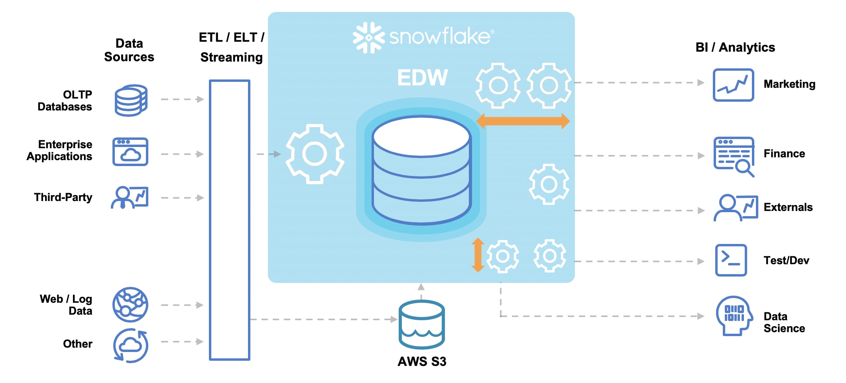
IRONHACK BOOTCAMP
CLOUD | DATAWAREHOUSE - SNOWFLAKE

Slide 21
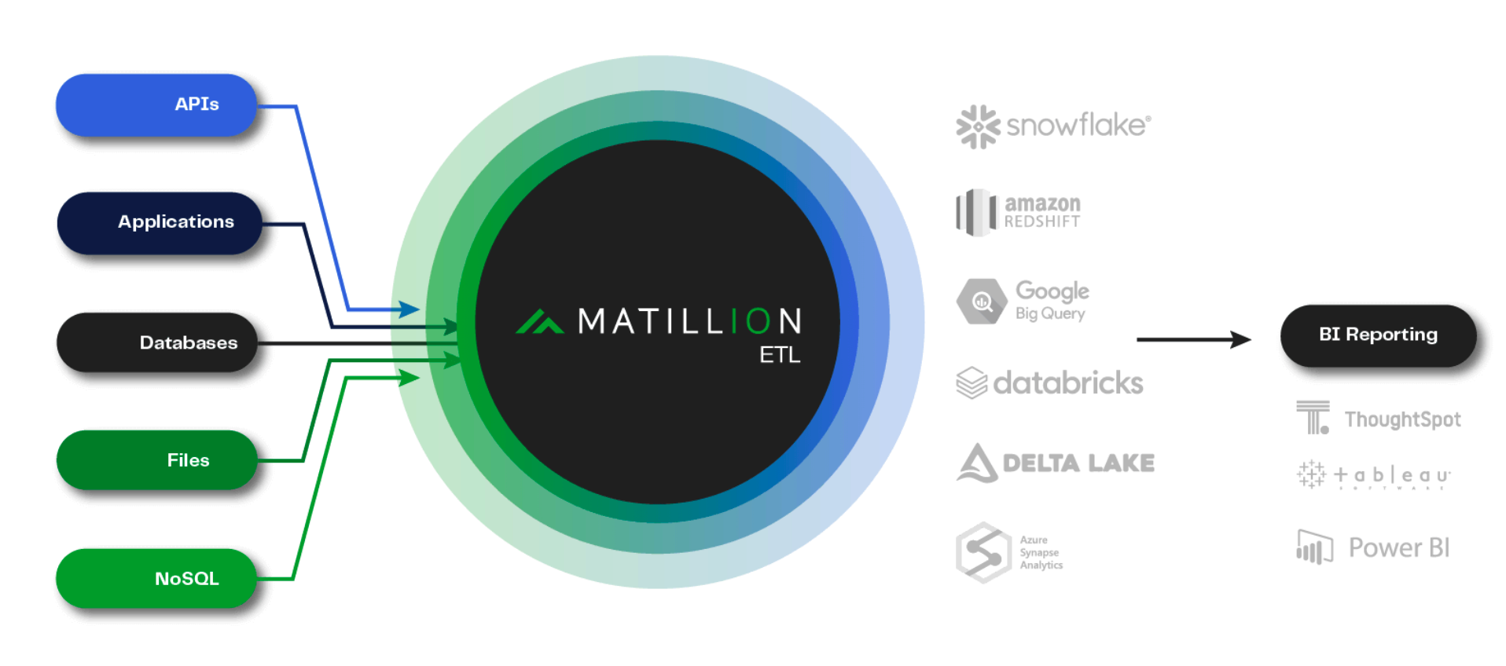
IRONHACK BOOTCAMP
CLOUD | ETL - MATILLION

Slide 22
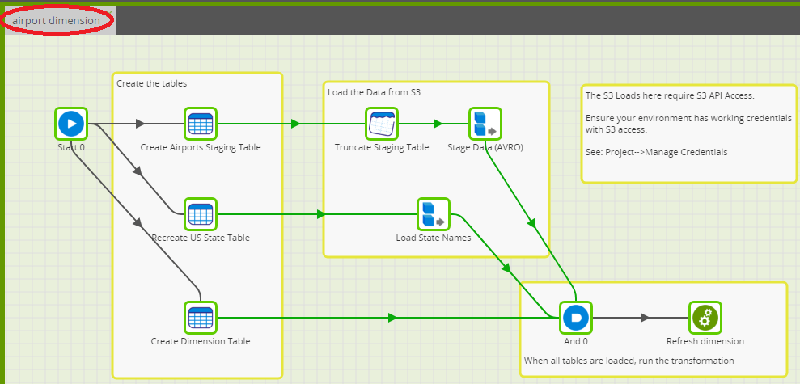
IRONHACK BOOTCAMP
CLOUD | ETL - MATILLION

Slide 23
IRONHACK BOOTCAMP
CLOUD | DATAWAREHOUSE - SNOWFLAKE

Slide 24
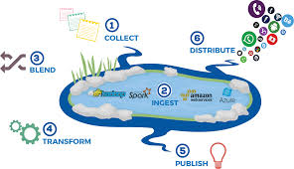
IRONHACK BOOTCAMP
What is it:
Central storage repository where data is dumped for future use
Holds big data from many sources
Stores structured, semi-structured, unstructured data in one place
The data is not clean or organised
Stored on inexpensive, scalable hardware – capacity is not an issue
BUT queries are run elsewhere
DATA | LAKE

Slide 25
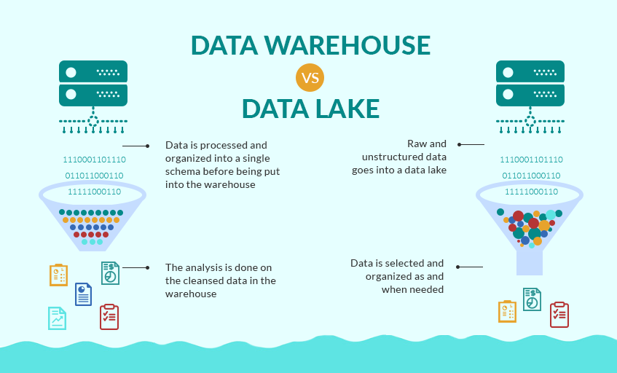
IRONHACK BOOTCAMP

Slide 26
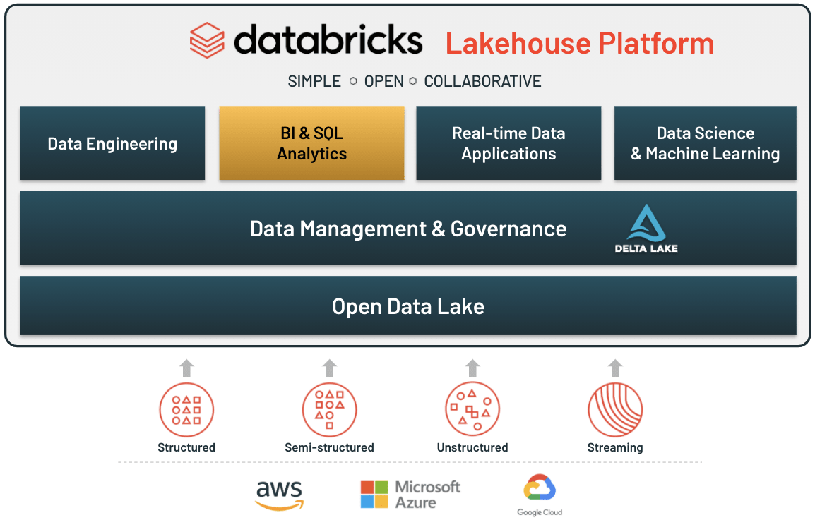
IRONHACK BOOTCAMP

Slide 27
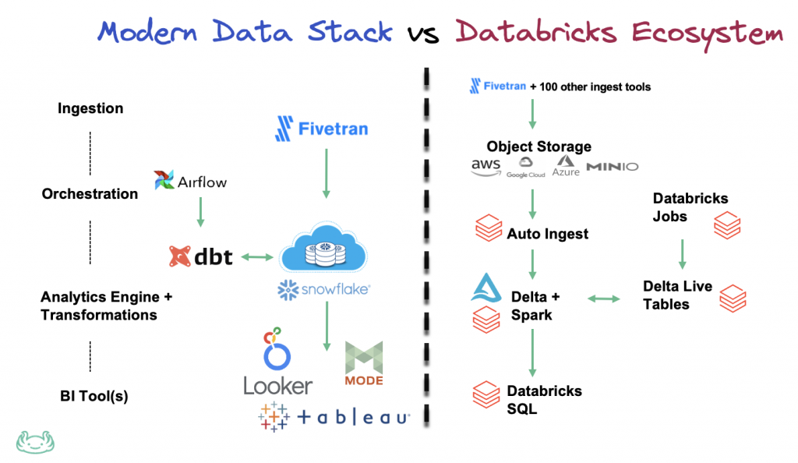
IRONHACK BOOTCAMP

Slide 28
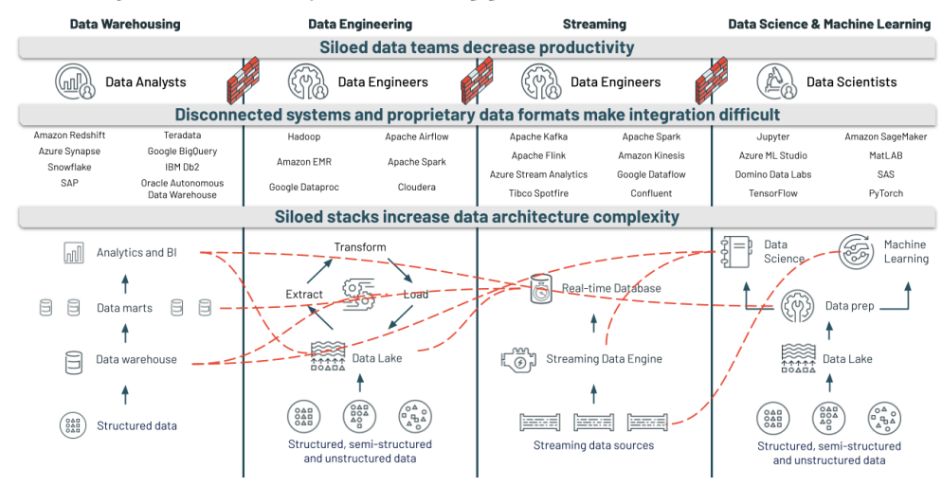
IRONHACK BOOTCAMP

Slide 29
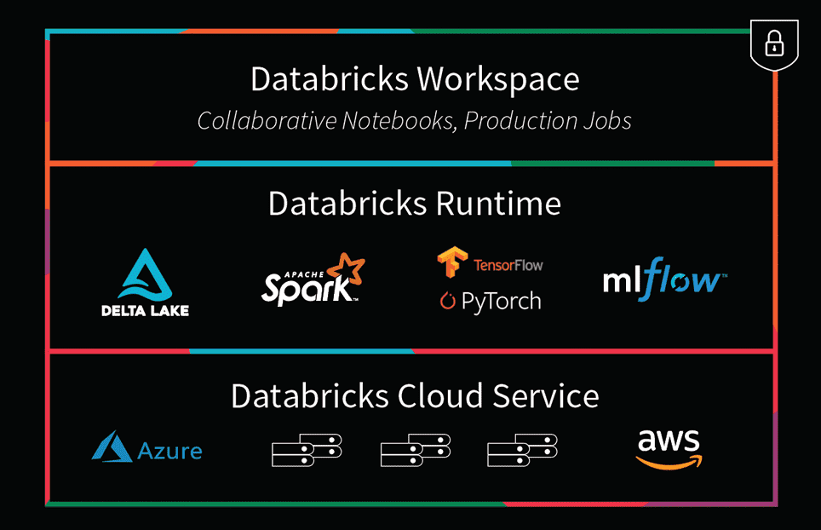
IRONHACK BOOTCAMP

Slide 30
Production architecture planning end to end

Slide 31
IRONHACK BOOTCAMP
CLOUD | ETL - MATILLION

Slide 32
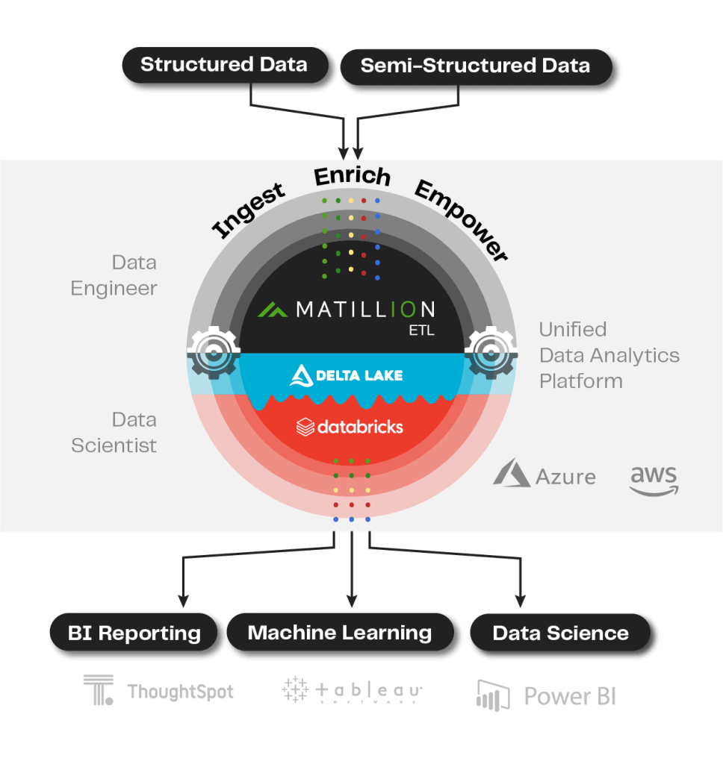
IRONHACK BOOTCAMP

Slide 33
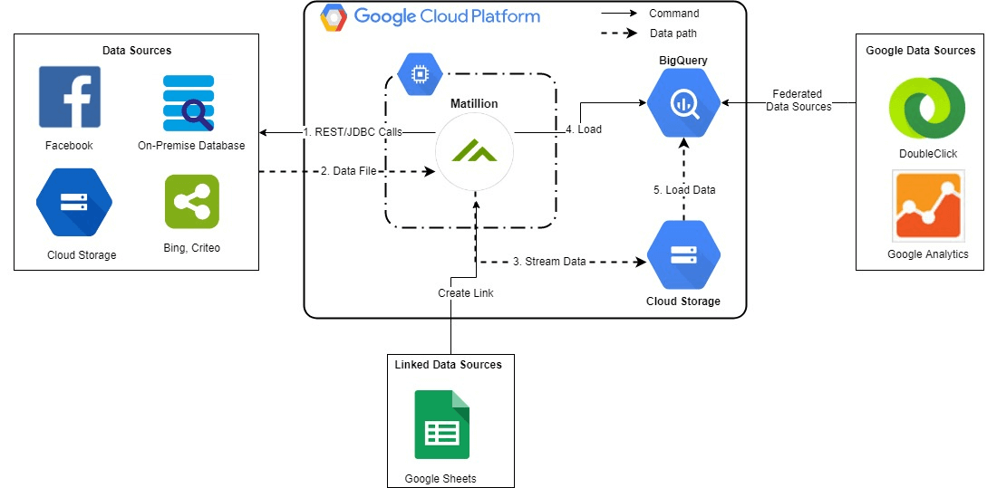
IRONHACK BOOTCAMP

Slide 34
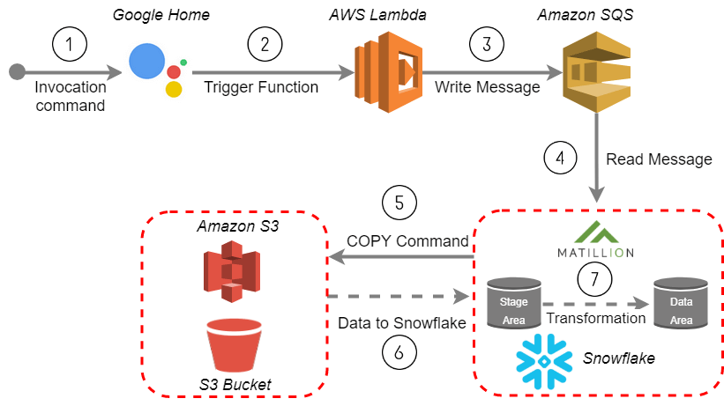
IRONHACK BOOTCAMP

Slide 35
Production architecture planning ahead in data science

Slide 36




IRONHACK BOOTCAMP
Example book publisher
case where data science
model needs to be live
Q: “What is the next best
seller /overnight success?”
Infrastructure
Reporting and analytics
Data science
Business decision maker - buyers

Slide 37
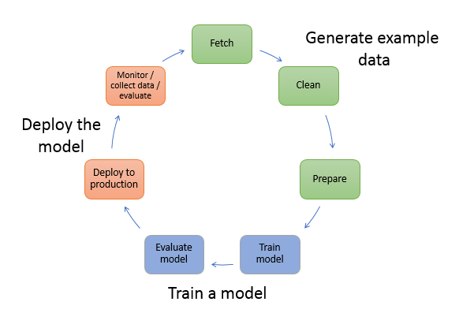

Slide 38
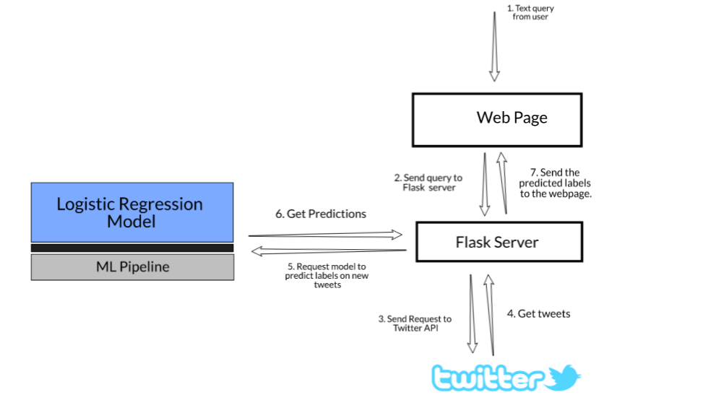
Deploy machine learning models to the business users (example with Flask)

Slide 39
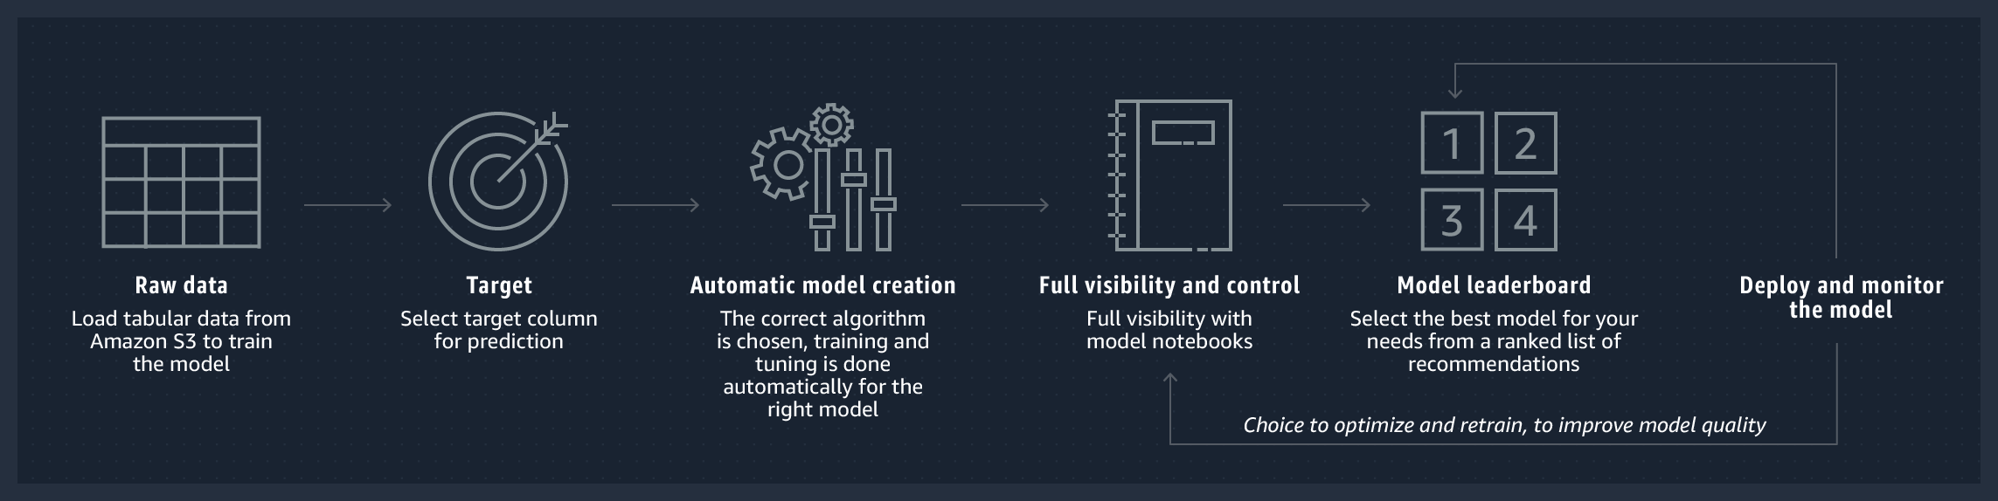
IRONHACK BOOTCAMP
Deploy machine learning models to the business users (example with Sagemaker)

Slide 40
IRONHACK BOOTCAMP

Slide 41


